Slide 1



Representation of Behaviour
Transformers for Life Event Sequences
Anna Rogers (Post-Doctoral Associate, KU)
Germans Savcisens (PhD Fellow, DTU)

Slide 2
Agenda
Intro
Theory Behind
Word Embeddings
Transformers and Self-Attention
BERT
Life2Vec
Data
Model
Findings
Ethical Considerations
Marked Slides: Slides skipped during the presentation

Slide 3
Introduction
Part I

Slide 4
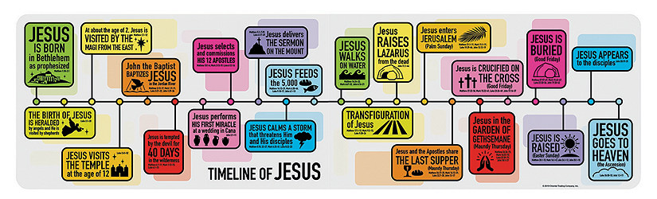
Representation of Life
12 | -2 | 10 | 5 | 39 | -30 | 20 | 33
(Compact Representation of Life Trajectory)

Slide 5
What can we do with it?
(Compact Representation of Life Trajectory)
12 | -2 | 10 | 5 | 39 | -30 | 20 | 33
Predictions. Input the representation to a ML algorithm to predict outcomes such as:
Life expectancy
Health trajectory
Socio-economic status
Exploration. Analyze space of people using the representation:
Embedding Space
Archetypal Analysis

Slide 6
SOTA I
Standardized codes
Visit (EHR): sex1 agegrp4 e13 r07 a10bh cpt54 cpt73 cpt97 hcpcg
Translation: Man in his 50s has visited a doctor and got Immunology-related and Cardiovascular-related services. The visit was connected to diabetes and pain in the throat or chest. He was prescribed with a blood glucose lowering drug (DPP-4).
Recent research:
use models from NLP area (RNNs, Hidden-Markov Models, Transformers etc.)
Notes:
Based on the ideas that come from NLP … we can take a sequence – human language…. Person with appropriate knowledge …
The idea is similar … Assign meaning to terms, learn to predict

Slide 7
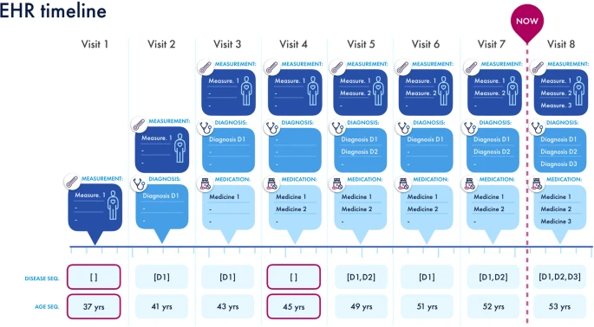
SOTA II
BERTH:
Based on theory from NLP
Uses Transformer-based model
Analyses sequences of diagnoses
Predicts the health-related outcomes (per patient)
Predict future diagnoses (in ICD-10):
On next visit
Within next 6 months
Within next year
Li, Y., Rao, S., Solares, J.R.A., Hassaine, A., Ramakrishnan, R., Canoy, D., Zhu, Y., Rahimi, K. and Salimi-Khorshidi, G., 2020. BEHRT: transformer for electronic health records. Scientific reports, 10(1), pp.1-12.

Slide 8
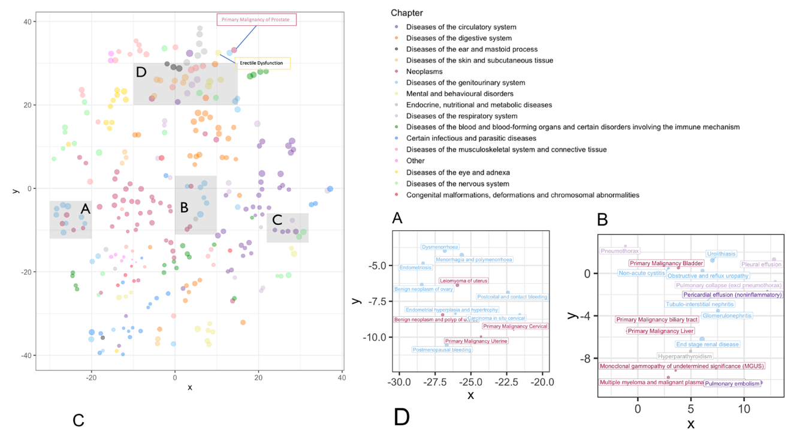
SOTA III

Slide 9
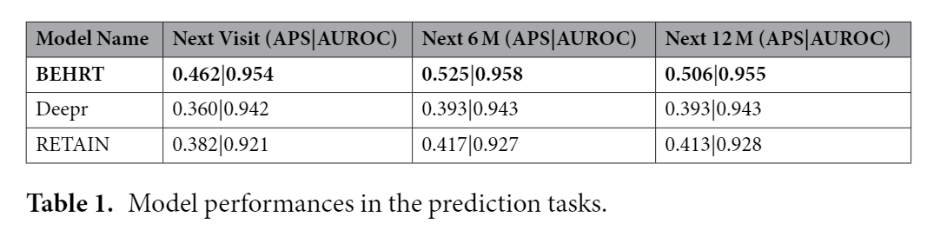
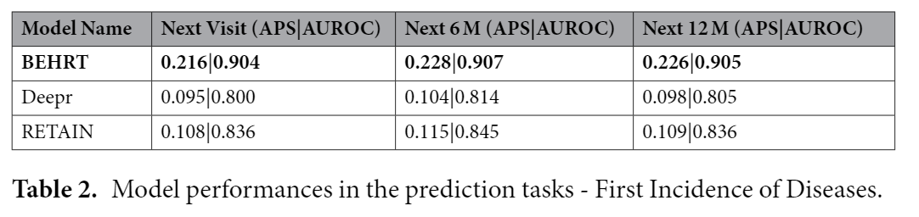
SOTA IV

Slide 10
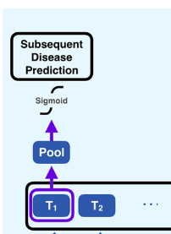
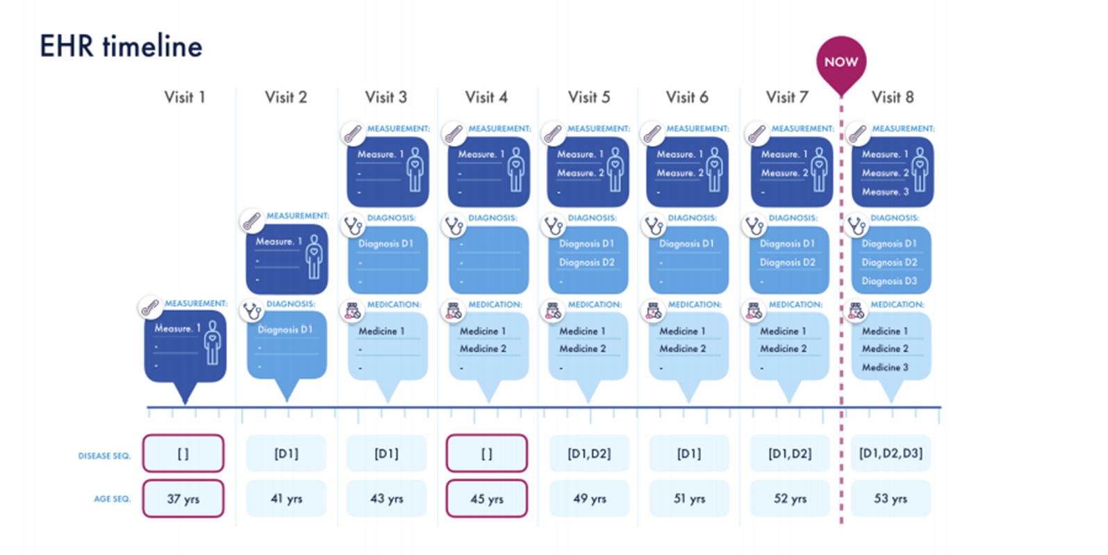
Disease Prediction
Used three scenarios for prediction of 301 diagnoses:
T1 (next visit)
T2 (next 6 months)
T3 (next 12 months)
1. Random cut
Prediction on the patient embedding
[D0, D9]
2. Becomes the input to BEHRT
3. Converts to multi-hot encoding
y = [ 1, 1, 1, 0 ,0 ,0 ,0 ,0 ,0 ,1, …. ]

Slide 11
Theory Behind
Part 2

Slide 12
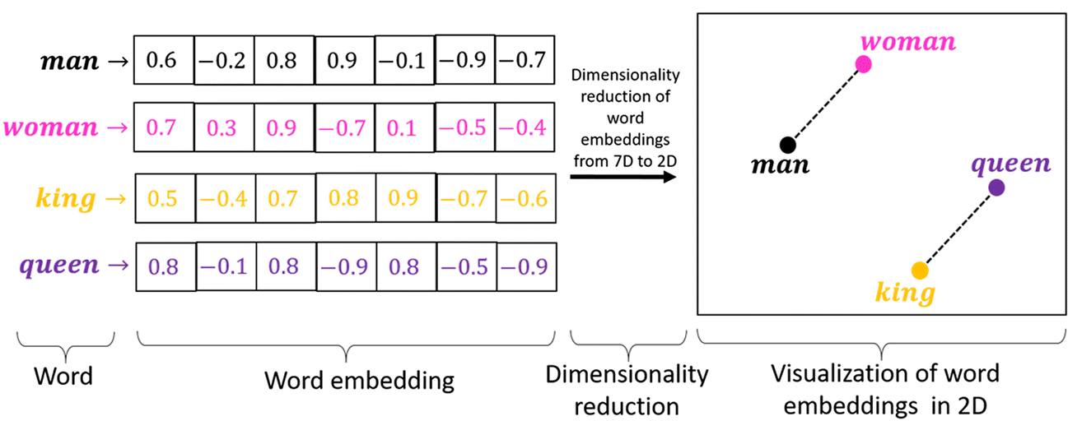
Word Embeddings I
Language is complicated
Machines cannot process words
We need to capture syntax, semantics, relationships etc.
Solution: represent words with numbers
Image source

Slide 13
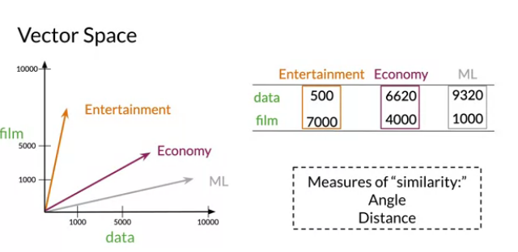
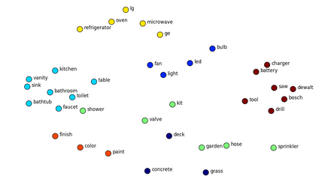
Word Embeddings II
We can employ different methods to create the word embeddings:
Manually assign values to each dimension (based on questionaries)
Frequency based: Count-Vectors, TF-IDF, N-grams
Prediction-based: SkipGram, CBOW, GLoVE
Prediction-based (Task-specific): a by-products of training ML algorithms (e.g. RNNs)
Image Source
Image Source II

Slide 14

Deep Learning Boom in NLP
AI winter
DL creeps in
Word2vec
Contextualized representations
Early AI work
Rule-based NLP
Statistical ML
ImageNet
1966
1980
1990
2000
2012
2013
2018
Source

Slide 15
The Power of Deep Learning
“One of the promises of deep learning is that it vastly simplifies the feature-engineering process by allowing the model designer to specify a small set of core, basic, or “natural” features, and letting the trainable neural network architecture combine them into more meaningful higher-level features, or representations.”
Y. Goldberg, "Neural network methods for NLP"

Slide 16
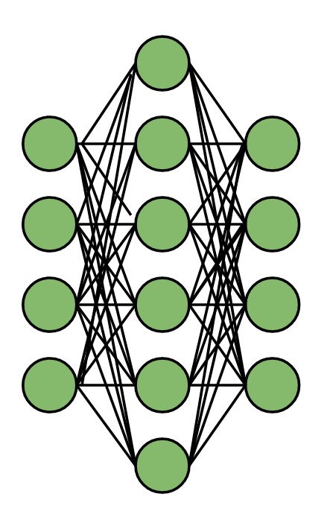
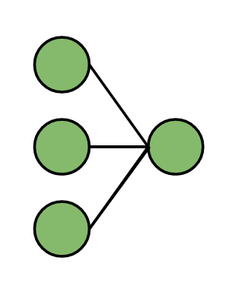
What are Neural Networks?
Fully-connected Feed-forward Neural Network
Logistic Regression
Input
Output
Input
Output

Slide 17
How do we train them?
Input
Output
Backpropagating the loss and updating the parameters
Repeatedly, across huge amount of samples

Slide 18
Neural Networks and Sequences I
Positive review
[1,0,3]
[1,1,2]
[9,0,7]
[2,2,7]
[1,2,7]
w
w
w
w
v
H_{t}
H_{t+1}
H_{t+2}
H_{t+3}
H_{t+4}
y
u(X_{t})
u(X_{t+1})
u(X_{t+2})
u(X_{t+3})
u(X_{t+4})
[0,3,2]
[1,-2,5]
[0,6,1]
[2,1,1]
[-2,-1,1]
I | really | like | the | actors
u, w, v –weights matrices
…but pure RNNs have issues
Notes:
Why do we need it ? We can use as part of the model

Slide 19
Neural Networks and Sequences II
Most likely it is going to be
overwritten by the word “like”
Positive review
[1,0,3]
[1,1,2]
[9,0,-9]
[1,1,-9]
[1,2,7]
[1,2,7]
[1,2,7]
w
w
w
w
w
w
v
H_{t}
H_{t+1}
H_{t+2}
H_{t+3}
H_{t+4}
H_{t+4}
H_{t+4}
y
u(X_{t})
u(X_{t+1})
u(X_{t+2})
u(X_{t+3})
u(X_{t+4})
u(X_{t+4})
u(X_{t+4})
[0,3,2]
[1,-2,5]
[0,6,1]
[1,-2,5]
[0,6,1]
[2,1,1]
[-2,-1,1]
I | did | not | really | like | the | actors
u, w, v –weights matrices
Potential Issues: long-term memory and sequence lengths

Slide 20
Neural Networks and Sequences III
Attention Mechanism. Model calculates how much contribution should each hidden state have for the final prediction.
In our case, it is a weights sum of hidden states (width of arrows specifies the contribution of a hidden state). Many more attention types exist.
Negative review
y
w
w
w
w
w
w
H_{t}
H_{t+1}
H_{t+2}
H_{t+3}
H_{t+4}
H_{t+4}
H_{t+4}
u(X_{t})
u(X_{t+1})
u(X_{t+2})
u(X_{t+3})
u(X_{t+4})
u(X_{t+4})
u(X_{t+4})
I | did | not | really | like | the | actors
u, w, v –weights matrices

Slide 21
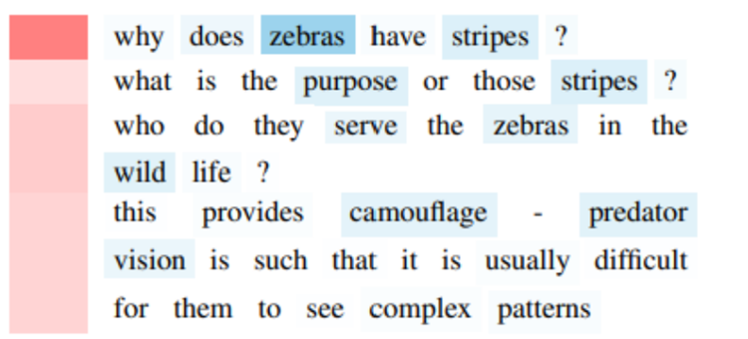
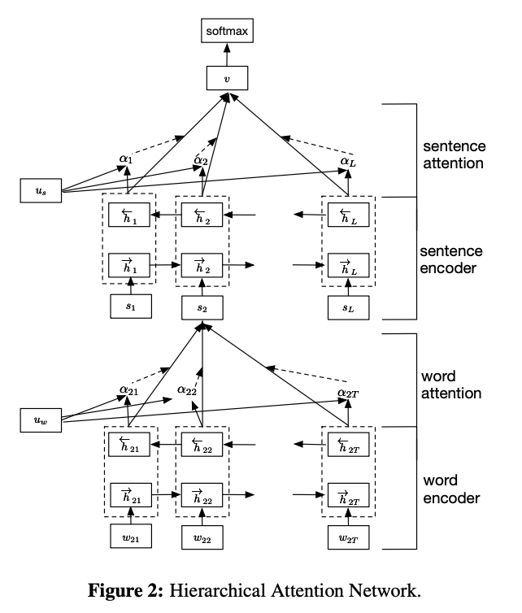
Attention: Example
We can see words and sentences that
model used to classify the text as “scientific”
Attention Mechanism:
Allows model to focus on the relevant information
Provides interpretability (see above)
…but still RNNs even with the Attention have issues: parallelisation, bi-directionality, hard to encode “distances” between events, tokens are processed one by one etc.

Slide 22
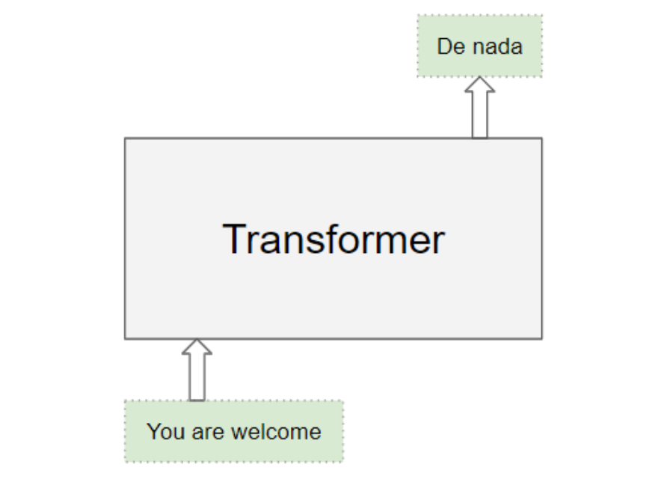
Attention is all you need
What if we keep only Attention >>> Transformers
Transformers use a special kind of Attention Mechanism
Transformers align words in a sequence with other words in the sequence (i.e., self-attention).
Self-attention is the method to bake the “understanding” of other relevant words into the one we’re currently processing (explained later)
Transformer. Model that efficiently encodes and decodes sequences
Vaswani, A., Shazeer, N., Parmar, N., Uszkoreit, J., Jones, L., Gomez, A. N., ... & Polosukhin, I. (2017). Attention is all you need. arXiv preprint arXiv:1706.03762.
Alammar, J. (n.d.). The Illustrated Transformer. [online] Visualizing machine learning one concept at a time. Available at: https://jalammar.github.io/illustrated-transformer/.

Slide 23
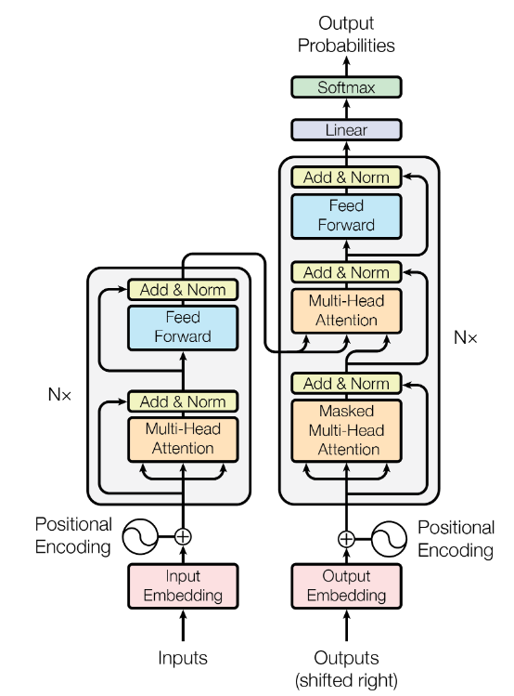
What is a Transformer?
Decoder
Encoder
Attention is
calculated here
Cui, B., Li, Y., Chen, M., & Zhang, Z. (2019, November). Fine-tune BERT with sparse self-attention mechanism. In Proceedings of the 2019 Conference on Empirical Methods in Natural Language Processing and the 9th International Joint Conference on Natural Language Processing (EMNLP-IJCNLP) (pp. 3539-3544).
Alammar, J. (n.d.). The Illustrated Transformer. [online] Visualizing machine learning one concept at a time. Available at: https://jalammar.github.io/illustrated-transformer/.

Slide 24
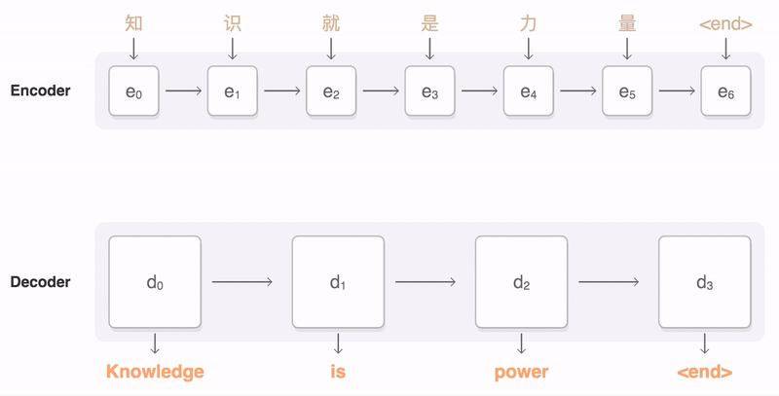
A bit about Sequence Modelling ^{(Visualisation)}

Slide 25
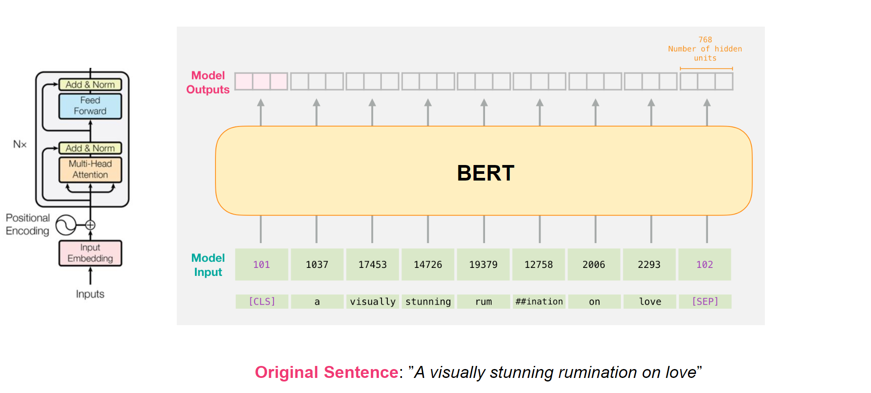
BERT I
BERT is a special version of a Transformer (has only the encoder part). It recalculates the representation of each word based on the context (i.e. other words I the sequence).
BERT is only an encoder
Alammar, J. (n.d.). The Illustrated Transformer. [online] Visualizing machine learning one concept at a time. Available at: https://jalammar.github.io/illustrated-transformer/.

Slide 26
BERT II
What you can do with the output:
Make predictions on the first token (CLS, more about that later)
Using any ML model
Feed the sequence further to:
RNN
Decoder part (of a Transformer)
If training setup correctly – first token might encode the information about the whole sequence

Slide 27
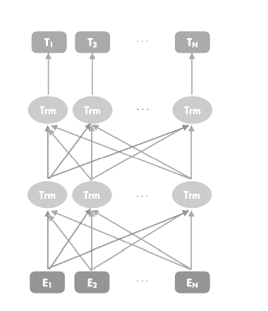
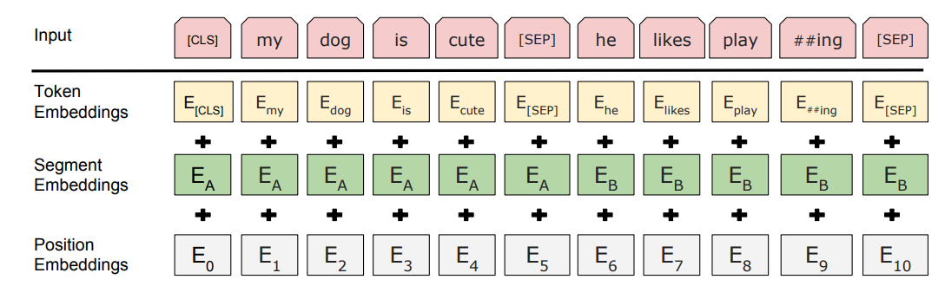
BERT III
Cool feature: Summary Token (also called CLS token aka Classification Token)
Input to the
Network
Cool feature: Positional Embeddings (i.e. injects positional/time information)
Vaswani, A., Shazeer, N., Parmar, N., Uszkoreit, J., Jones, L., Gomez, A. N., ... & Polosukhin, I. (2017). Attention is all you need. arXiv preprint arXiv:1706.03762.

Slide 28
Self-Attention I
How does it calculate the contextual-representation? With Self-Attention!
Let’s assume we have sentence: The dog run.
Workflow (Simplified):
Lookup embeddings for each word (or take the ones from a previous block)
Transform each embedding into Key, Query and Value (those are just names for transformed versions of embeddings)
the
dog
ran
9 | 2 | 1
-1 | 3 | 4
-1 | 3 | 4
the
dog
ran
9 | 2 | 1
-1 | 3 | 4
-1 | 3 | 4
u
v
u
v
u
v
w
w
w
0 | 2 | 3
1 | 2 | 1
0 | 1 | 0
3 | 1 | 6
1 | 4 | 9
9 | -2 | 1
7 | -2 | 0
8 | 2 | 5
0 | 1 | 3
u, w, v – Feed forward layer

Slide 29
Self-Attention II
Calculate attention scores for each word (dot product):
Calculate contextualized embedding:
Do for each word
Pass embeddings to a next block and repeat (now with the contextualized)
query
key
score
softmax normalised
the
7 | -2 | 0
0 | 2 | 3
the
-4
.05
the
7 | -2 | 0
0 | 1 | 0
dog
-2
.25
the
7 | -2 | 0
1 | 4 | 9
ran
-1
.70
This is a contextualized embedding for “the”
value
value
value
7 | 1 | 2
.05
1 | 2 | 1
.25
3 | 1 | 6
.70
9 | -2 | 1
the
dog
ran

Slide 30

Multi-Head Self-Attention
Multiple Self-Attention units in parallel per layer
Each unit gets different projection weights of K, V, Q
Vaswani, A., Shazeer, N., Parmar, N., Uszkoreit, J., Jones, L., Gomez, A. N., ... & Polosukhin, I. (2017). Attention is all you need. arXiv preprint arXiv:1706.03762.

Slide 31
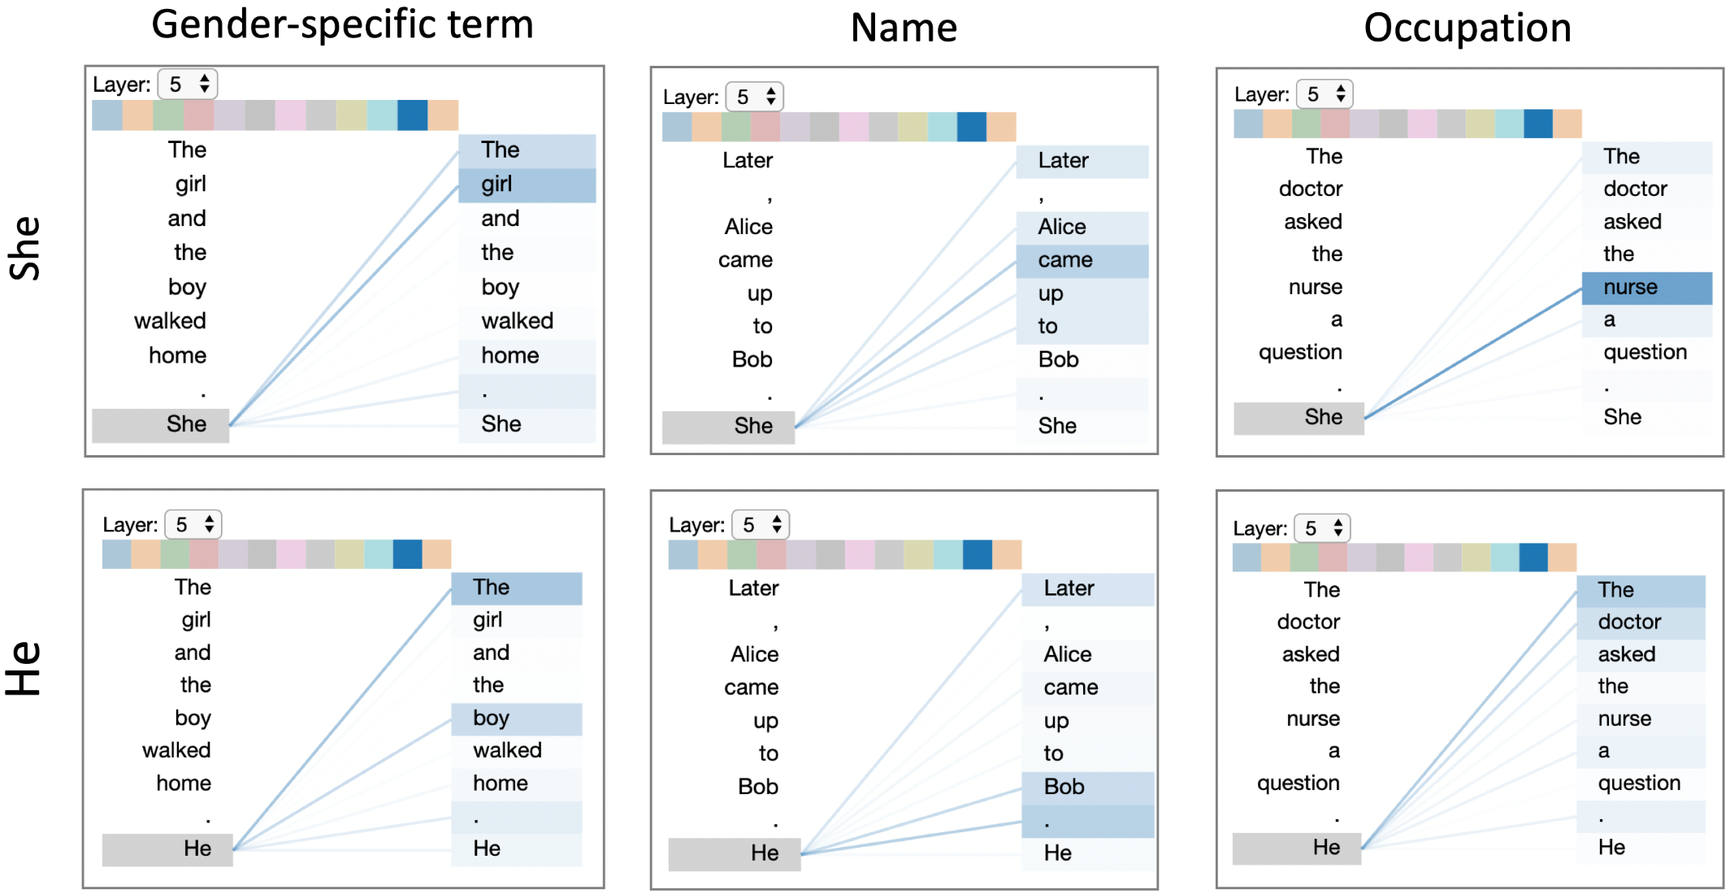
Self-Attention III: Visualization of scores
Vig, J., 2019. Visualizing attention in transformer-based language representation models. arXiv preprint arXiv:1904.02679.

Slide 32
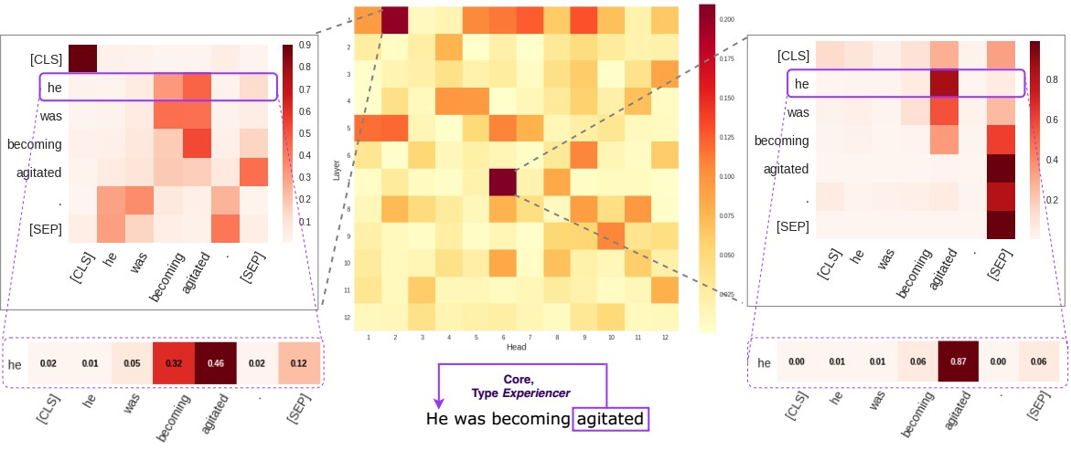
Self-Attention IV: Scores
Image Source

Slide 33
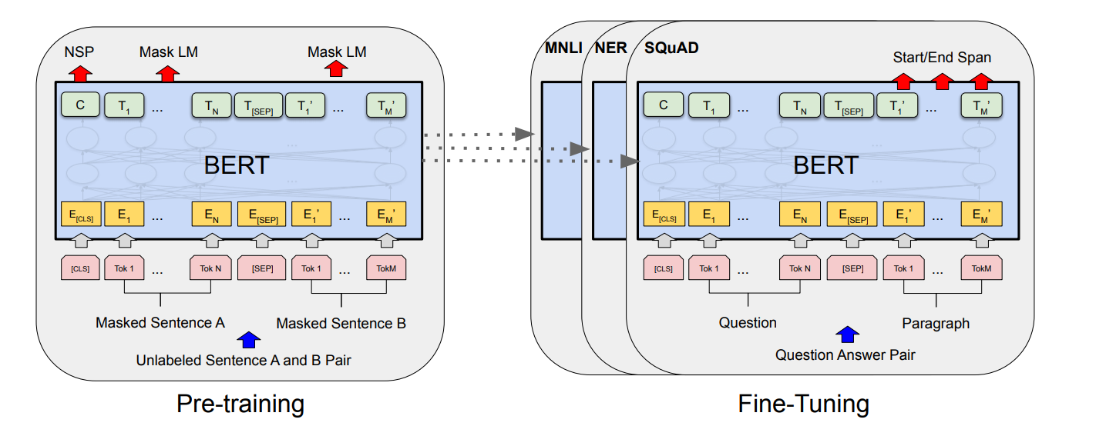
BERT: Framework
Vaswani, A., Shazeer, N., Parmar, N., Uszkoreit, J., Jones, L., Gomez, A. N., ... & Polosukhin, I. (2017). Attention is all you need. arXiv preprint arXiv:1706.03762.
Multi-Genre Natural Language Inference
Named-entity recognition
Question answering and/or reading comprehension
Stage 1: Pre-training
Randomly initialise network
Train on Masked Language Model task (and sometimes on Next Sentence Prediction)
The “heaviest” and “longest” stage
Stage 2: Fine-Tuning
Use pre-trained model (i.e. learnt parameters)
Train it even more (but with a relevant task)
This framework provides superior results on many NLP task (compared to RNNs).

Slide 34
BERT: Pre-training
Mask 15% of tokens (not including [PAD], or padding token):
10% unchanged
10% substituted with random tokens
80% substituted with the [MASK] token
[CLS] | I | did | not | really | like | actors | in | that | movie | [PAD]
[CLS] | I | [MASK] | not | really | yoga | actors | [MASK] | that | movie | [PAD]
BERT (at this point, the model does not know which tokens we will ask to predict)
Here we ask our model to provide predictions at specific positions
?
?
?
?

Slide 35
BERT: How do we learn Embeddings?
After each step

Slide 36
BERT: Fine-tuning
We use pre-trained model
..but continue to train on a specific task
We do not mask words anymore
Let’s assume we have a classification task
[CLS] | I | did | not | really | like | actors | in | that | movie | [PAD]
Pre-trained BERT
After we pass our sequence through BERT, we will pool the contextual representation of CLS
Make a prediction based on CLS representation
Is it a positive review?

Slide 37
Magical [CLS]
All in all, CLS is just a storage space (or placeholder).
Model can fill it with any kind of information
Assumption: Model learns to fill it with the important information (based on the specific task).
[CLS]
TRANSFORMER LAYERS
[CLS]
I
DID
NOT
LIKE
THE
ACTORS
[PAD]

Slide 38
Life2Vec
Part 3

Slide 39

Data I
Labour Data
(2008 – 2018)
Health Data (first contact)
(1951 – 2018)
Education Data
(not used yet)

Slide 40
Data: Labour Data I
Data: Each income you get is recorded
Income (if applicable):
Salary + ATP-contributions
Benefits/pensions/scholarships
Other income
Residence
Country of Origin / Citizenship
Address in Denmark
Socio-economic status:
Age and sex
Employment status (includes industry, level of position, type of employment, working-hours)
Social status: retiree, student etc.
… | Industry Field | Position | Income | ATP Level | A-tax + ATP | De minimis | Time | Social Status | SS Modifier | Period of the record
… | 53 | 235200 | 12890.0 | A | 5956.0 | False | 57 | 110 | 11080 | …
Natural resources
Military inventories
Management of HR
Actor, Hunter, TA
Student with SU,
Holiday benefits,
Mid-level employee
Foreign student,
Internship,
State Pension
*colored variables are categorized

Slide 41
Data: Labor Data II
Positions are encoded according to International Standard Classification of Occupations (ISCO-08) – has hierarchies, but inconsistent 2008 vs 2010. Adapted
2111 Physicists and astronomers
5141 Barbers
2460 Pastors
Sectors are encoded according to European system of accounts (ESA2010). Adapted
31 State owned institution
80 Private
90 Foreign
Industries are classified according to Dansk Branchekode 2007:
108400 Preparation of flavorings and spices
643040 Venture companies and private equity funds
889920 Refugee and asylum centers
Adapted: Some changes were made in Denmark

Slide 42
Data: Labor Data III
Continuous variables are binned into categories
Based on quantiles:
Income has a granularity of 100
Time has a granularity of 10
ATP has a granularity of 10

Slide 43
Data: Health Data
Data: Initial visit to a health practitioner or hospital
Variables:
Diagnosis (Initial, no follow ups)
Patient type: inpatient, outpatient and emergency
Urgency: Urgent, Non-urgent
Does not include psychiatric records (and follow up visits)
Diagnosis on initial visit might not be true (e.g. changes on the following visits)

Slide 44

Health Data: Standardized Classification System
Maintained by World Health Organisation
Encodes diseases and procedures/services
~69k diseases codes
~70k procedures/services codes
Denmark uses both code sets
Some examples:
Y93.D: Activities involved arts and handcrafts
W61.62XD: Struck by duck, subsequent encounter
H47.51: Disorders of visual pathways in (due to) inflammatory disorder
We only use category and etiology: W61.6, H47.5 etc.

Slide 45
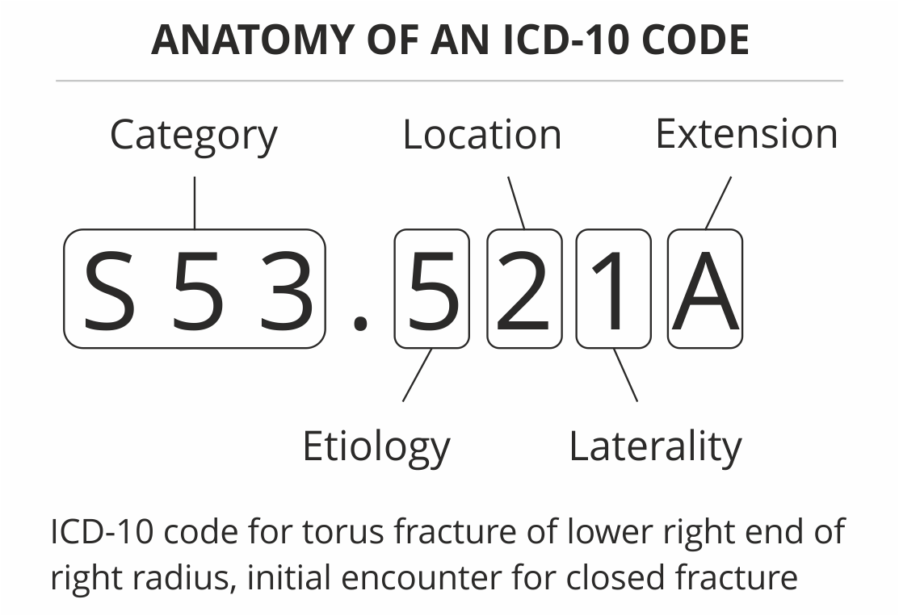
ICD-10
Example:
D Diseases of the blood and blood
D30 Benign neoplasm of urinary organs
D30.0 Benign neoplasm of kidney
D30.00 Benign neoplasm of unspecified kidney
D30.01 Benign neoplasm of right kidney
D30.02 Benign neoplasm of left kidney
Etiology: cause or set of causes
Laterality: left/right side
Image source

Slide 46

Data to Sequence I
Data presented does not belong to any existing person (i.e. it is made up)
Data of a specific person in the Labour Database
PERSON: XXXABC
PERSON_ID | DATE | POSITION | TIME | SOC_STAT | SEX | INCOME | …
XXXABC | 31.01.07 | 235200 | 32 | 110 | M | 12039
XXXABC | 30.03.07 | - | 108 | 517 | M | 6000
XXXABC | 30.03.07 | 235200 | 48 | 110 | M | 14029
XXXABC | 25.07.10 | - | 136 | 200 | M | 13000
…
Lookup
Data of a specific person in the Health Database
PERSON_ID | DATE | DIAGNOSIS | URGENCY | PAT_TYPE
XXXABC | 10.01.08 | J84.115 | NON-URGENT | INPATIENT
XXXABC | 22.12.15 | S58.1 | URGENT | AMBULANCE
…
Lookup

Slide 47
Data to Sequence II
Data presented does not belong to any existing person (i.e. it is made up)
Data of a specific person in the Labour Database
PERSON_ID | DATE | POSITION | TIME | SOC_STAT | SEX | INCOME | …
XXXABC | 31.01.07 | 235200 | 32 | 110 | M | 12039
XXXABC | 30.03.07 | - | 108 | 517 | M | 6000
XXXABC | 30.03.07 | 235200 | 48 | 110 | M | 14029
XXXABC | 25.07.10 | - | 136 | 200 | M | 13000
…
PERSON_ID | … | ORIGIN | SENTENCE
XXXABC |  | 51 | POS_235 TIME_3 SS_110 INCOME_9 …
XXXABC |  | 51 | POS_235 TIME_4 INCOME_9
Data of a specific person in the Health Database
PERSON_ID | DATE | DIAGNOSIS | URGENCY | PAT_TYPE
XXXABC | 10.01.08 | J84.115 | NON-URGENT | INPATIENT
XXXABC | 22.12.15 | S58.1 | URGENT | AMBULANCE
…
PERSON_ID | DATE | SENTENCE
XXXABC | 10.01.08 | J84 NU INPATIENT
XXXABC | 22.12.15 | S58 U AMBULANCE

Slide 48
Data to Sequence III
Data presented does not belong to any existing person (i.e. it is made up)
PERSON_ID | SEX | ORIGIN | BIRTHDAY | BIRTHDAY | SEQUENCES
XXXABC | M | 51 | 25/03/89 | DOCUMENT | [POS_235 TIME_3 SS_110 INCOME_9 …], [POS_235 TIME_4, INCOME_9 …], [J84, NU, INPATIENT], …
 |  |  |  | AGE | 18,18,18,19 …
 |  |  |  | DATE | 31.01.07, 30.03.07, 30.03.07, 10.01.08 …
 |  |  |  | ABSPOS | 0, 58, 58, 344
PERSON_ID | … | ORIGIN | SENTENCE
XXXABC |  | 51 | POS_235 TIME_3 SS_110 INCOME_9 …
XXXABC |  | 51 | POS_235 TIME_4 INCOME_9
…
PERSON_ID | DATE | SENTENCE
XXXABC | 10.01.08 | J84 NU INPATIENT
XXXABC | 22.12.15 | S58 U AMBULANCE
…
The data structure for each person

Slide 49
Data Filtering
Requirements for a person:
Person should have at least 12 records in Labor data (period 2008-2018)
We do not take into account whether a person is in the Health Dataset
Have a PERSON_ID (deidentified ID of a person)
Have a record of a birthday, origin and sex.
If a record of a birth, origin or sex is inconsistent throughout the dataset – person is removed

Slide 50
Vocabulary
Each token/word like POS_255, INC_9 become part of our vocabulary
As English has word such as dog, cool, go etc. which form its vocabulary
In our case, we have a language that consist of words/concepts related to labor and health.
We further refer to INC_9, TIME_4, SECTOR_81 etc. as concepts
So far, our language has approx. 4500 words.

Slide 51
Input Structure
Token to store sequence embedding
Background info: origin, sex, birthday
Single “sentence”
Sequence
[CLS]
ORIGIN
SEX
[SEP]
TOKEN
TOKEN
[SEP]
TOKEN
…
Abs Pos*
0
0
0
0
0
0
0
63
…
Age
45
45
45
45
45
45
45
45
…
*Abs Pos = # of days ( [Date of a current event] - [date of a first event] )

Slide 52
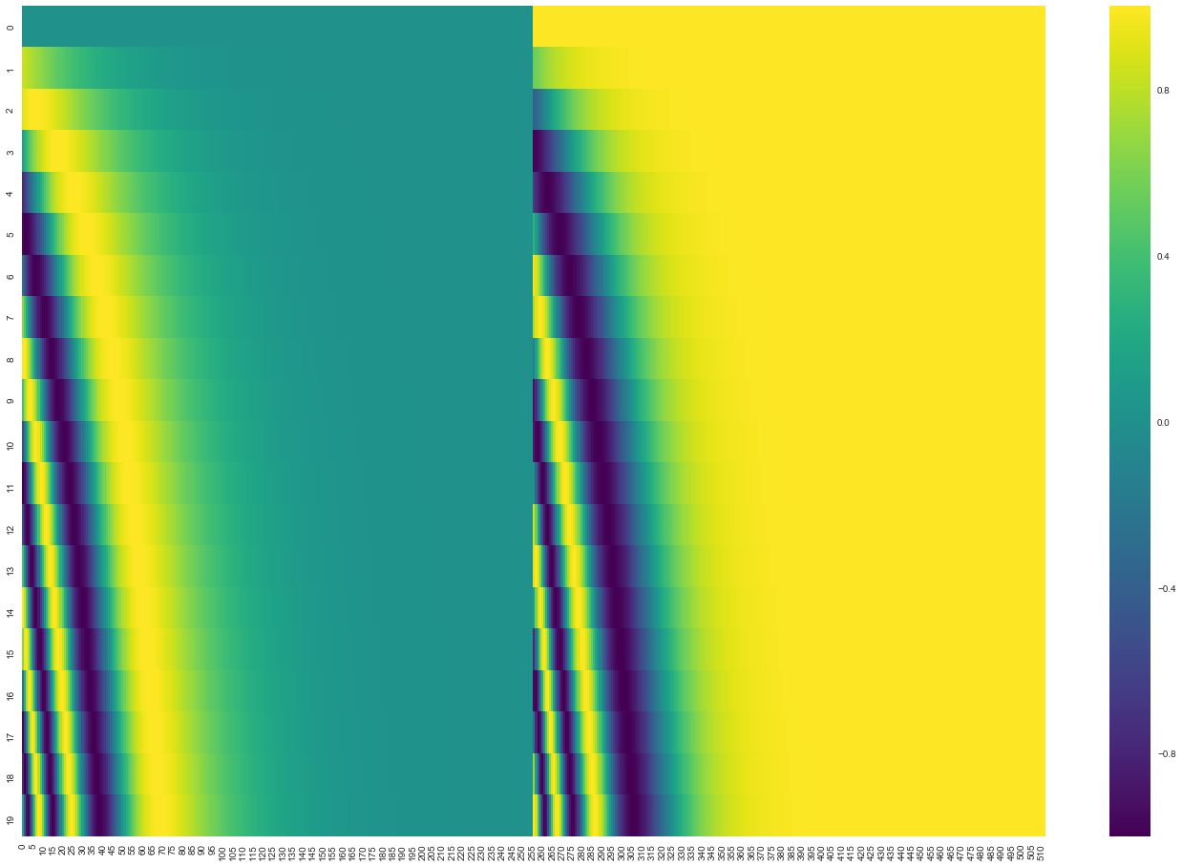
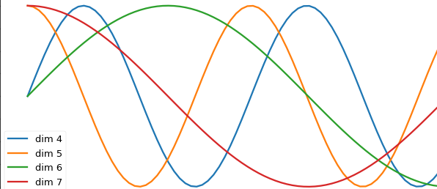



Time Encoding
We transform tokens/concepts into embeddings, but what happens with AGE and ABSPOS:
We can indeed train embeddings for each value of AGE and ABSPOS
To keep model simple, we use sinusoid waves (of different phases and frequencies)
Model learns to interpret them
$$\sin\left(ω_{n}t+φ_{n}\right)$$
We take values of each sine
wave at a certain t:
e.g. embedding for AGE_21
DIMENSIONS
…
$$\sin\left(ω_{1}t+φ_{1}\right)$$
$$\sin\left(ω_{0}t+φ_{0}\right)$$
TIME

Slide 53
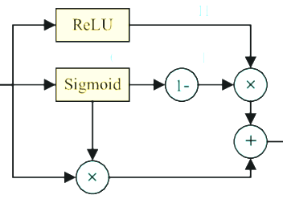
Model Architecture
SN
Scale Norm ⁵
ENCODER
FF
Feedforward layer
Gate B
Position-wise FF
⁶
Gate X
SN
Output
Gate A
Details:
Unit is shared across all encoders (ALBERT Implementation) ¹
Performer Attention Unit ²
Pre-norm Layers (instead of the Post-Norm) ³
ALBERT style embeddings ¹
We use weight tying ⁵
Highway flow (substitute “add” with a gate) ⁶
FF
Unit is shared across all encoders
(e.g. weights)
FAVOR+ Attention
Local Head
FF
FF
FF
SN
References:
Lan, Z., Chen, M., Goodman, S., Gimpel, K., Sharma, P. and Soricut, R., 2019. Albert: A lite bert for self-supervised learning of language representations. arXiv preprint arXiv:1909.11942.
Choromanski, K., Likhosherstov, V., Dohan, D., Song, X., Gane, A., Sarlos, T., Hawkins, P., Davis, J., Mohiuddin, A., Kaiser, L. and Belanger, D., 2020. Rethinking attention with performers. arXiv preprint arXiv:2009.14794.
Xiong, R., Yang, Y., He, D., Zheng, K., Zheng, S., Xing, C., Zhang, H., Lan, Y., Wang, L. and Liu, T., 2020, November. On layer normalization in the transformer architecture. In International Conference on Machine Learning (pp. 10524-10533). PMLR.
Parisotto, E., Song, F., Rae, J., Pascanu, R., Gulcehre, C., Jayakumar, S., Jaderberg, M., Kaufman, R.L., Clark, A., Noury, S. and Botvinick, M., 2020, November. Stabilizing transformers for reinforcement learning. In International Conference on Machine Learning (pp. 7487-7498). PMLR.
Pappas, N., Werlen, L.M. and Henderson, J., 2018. Beyond weight tying: Learning joint input-output embeddings for neural machine translation. arXiv preprint arXiv:1808.10681.
Nguyen, T.Q. and Salazar, J., 2019. Transformers without tears: Improving the normalization of self-attention. arXiv preprint arXiv:1910.05895.
SN
Embedding Layer

Slide 54
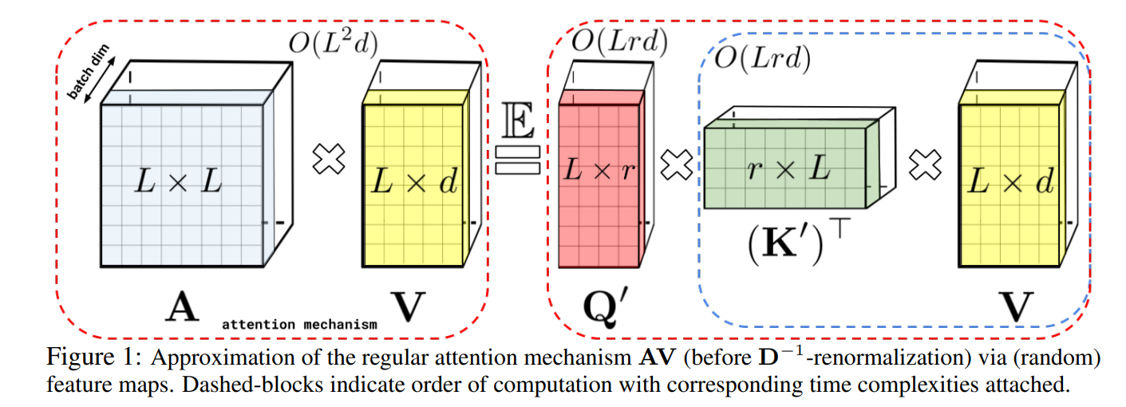
Performer: Self-Attention for Long Sequences
Choromanski, K., Likhosherstov, V., Dohan, D., Song, X., Gane, A., Sarlos, T., Hawkins, P., Davis, J., Mohiuddin, A., Kaiser, L. and Belanger, D., 2020. Rethinking attention with performers. arXiv preprint arXiv:2009.14794.

Slide 55
Pre-Training: Where does it look?
Let’s assume model needs to guess what is the masked token here:
[POS_235 TIME_9 INCOME_9 …], [ [MASK] TIME_4, INCOME_2 …], [POS_235 TIME_9 INCOME_9 …], ..
We were afraid that model simply copies information from past and future
…but our model does “understand” that since TIME and INCOME are different, hence, the position is also different (thus, predicting a token that might have not appeared in the sequence)

Slide 56
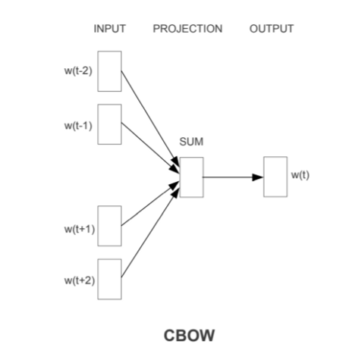
Continuous Bag-of-Words
Simpler model like CBOW can also successfully fill in the missing words into our sentences
We provide one sentence at a time and ask model to predict what is the most probable token
Does not consider the whole sequence, just isolated sentences
Embedding spaces of CBOW model and BERT look similar
Need to make valid comparison
Mikolov, T., Le, Q.V. and Sutskever, I., 2018. Exploiting similarities among languages for machine translation (2013). arXiv preprint arXiv:1309.4168.

Slide 57
Pre-Training: Ablation Studies
[SEP] token:
In NLP, introduced to separate sentences in BERT (due to the task specifications)
We assumed that it did not provide any benefits
However, the model without [SEP] has lower performance (i.e. 10% difference on F1-score)
Local vs Global (Performer-type attention) Attention:
Local attention only considers tokens around (window of 100 tokens max)
Removal of Global attention does not provide benefits in pre-training
Model performs better without it
Might not be conclusive as we trained small models for limited amount of time
Model might still utilize it during fine-tunning
Removing the local attention degrades the performance
Gates:
Without gates the model converges to loss of approx. 3.1
With gates the model converges to loss of 0.4
Loss: Cross Entropy (0 is perfect)

Slide 58
Pre-Training: Hyperparameter Search
Based on Implementation v6 (first) and v7 (rest)
Embedding Size | Hidden Size | FF Size | Heads | Encoders | Local Heads | Local Heads (Frac) | Window Size | Features | F1 (epoch 5)
64 | 512 | 1536 | 16 | 7 | 4 | 0,24 | 64 | 256 | 0,22
128 | 512 | 1536 | 8 | 4 | 0 | 0 | 0 | 435 | 0,132
256 | 352 | 1536 | 8 | 9 | 4 | 0,5 | 17 | 216 | 0,276
256 | 352 | 1536 | 16 | 5 | 13 | 0,86 | 3 | 216 | 0,22
320 | 448 | 1536 | 8 | 4 | 5 | 0,57 | 42 | 354 | 0,236
160 | 516 | 1024 | 12 | 5 | 5 | 0,4 | 129 | 172 | 0,279
96 | 444 | 1024 | 12 | 8 | 6 | 0,5 | 22 | 64 | 0,232
160 | 320 | 512 | 4 | 8 | 2 | 0,4 | 50 | 407 | 0,283
320 | 320 | 512 | 4 | 9 | 2 | 0,32 | 136 | 215 | 0,288
256 | 256 | 1024 | 8 | 1 | 6 | 0,68 | 132 | 335 | 0,248
320 | 320 | 2048 | 8 | 10 | 2 | 0,3 | 142 | 464 | 0,286
320 | 512 | 512 | 4 | 10 | 4 | 0,95 | 92 | 118 | 0,289
160 | 448 | 1024 | 8 | 9 | 6 | 0,76 | 107 | 397 | 0,264
320 | 252 | 1024 | 12 | 10 | 8 | 0,59 | 56 | 271 | 0,283
128 | 612 | 512 | 12 | 10 | 10 | 0,87 | 24 | 413 | 0,235
Search via Bayesian Optimization (trained for 5 epochs on small set of data) ^{Not a full list of samples}
Green rows: Top 3 best performing configurations
Yellow row: corresponds to a model v6.2.391 (most results are presented based on this model)

Slide 59
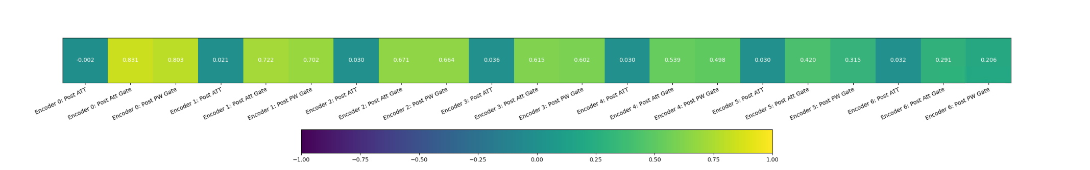
Pre-training: Layer contribution I
Based on Model v6.2.391
Average Cosine Distance between the original embeddings and contextual embeddings:
Gates prevents the top attention layers from changing the embeddings
Lower the value, “higher” the difference

Slide 60
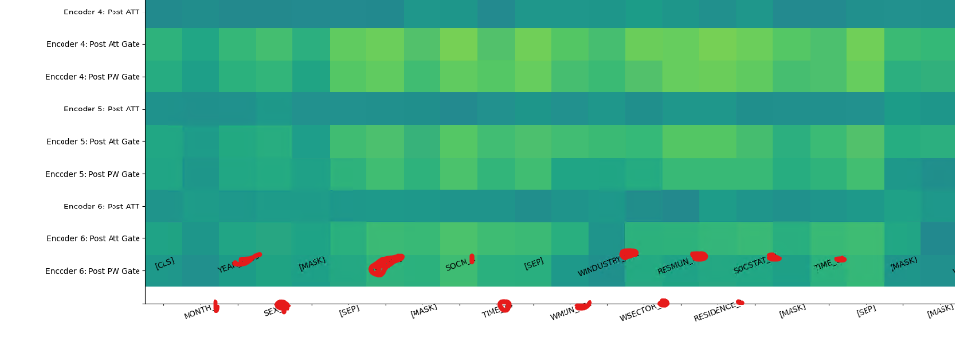
Pre-training: Layer Contribution II

Slide 61
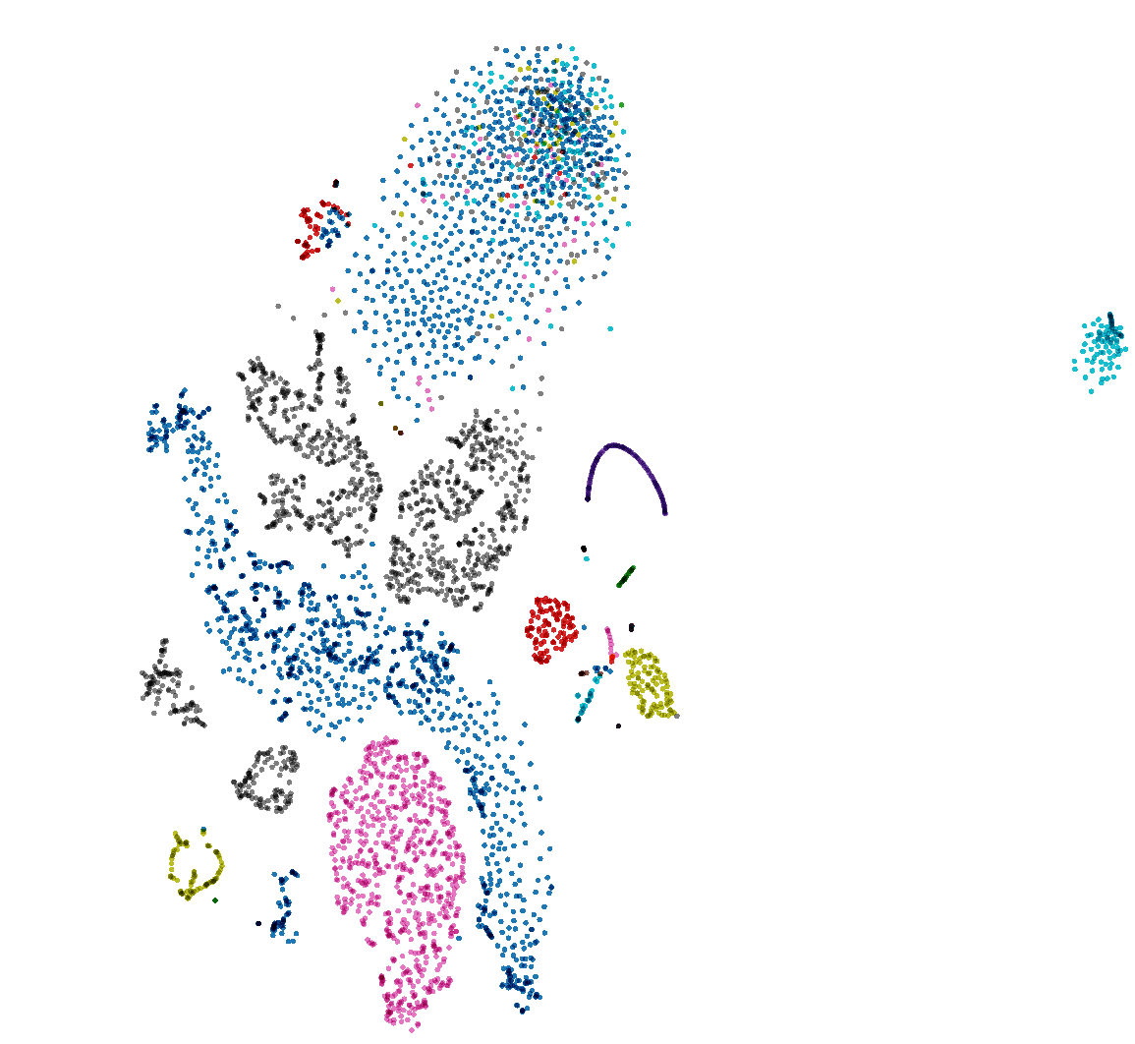
Embedding Space
Based on Model v6.2.391
Positions
(forms 4 separate clusters)
Visualization of high dimension concept embeddings
Projected to 2D with T-SNE (non-linear projection)
Colored according to concept type
Social Status
Work Field
Cloud of diagnoses
Work Municipality
Income

Slide 62
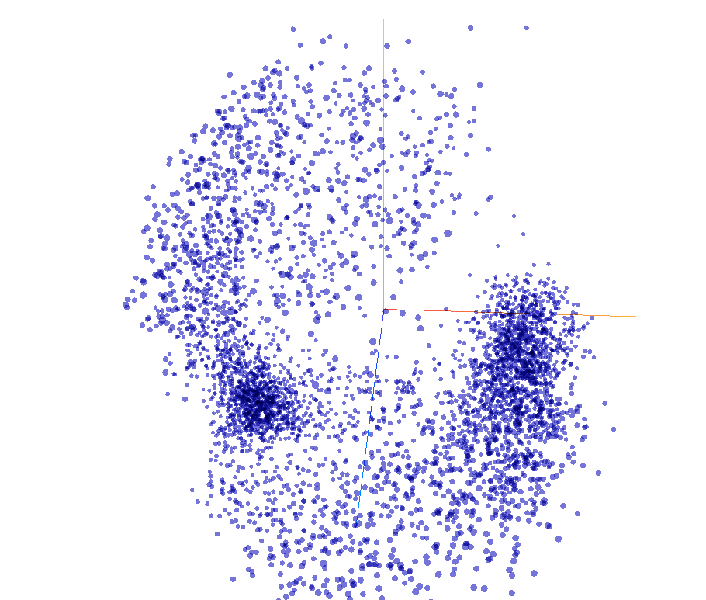
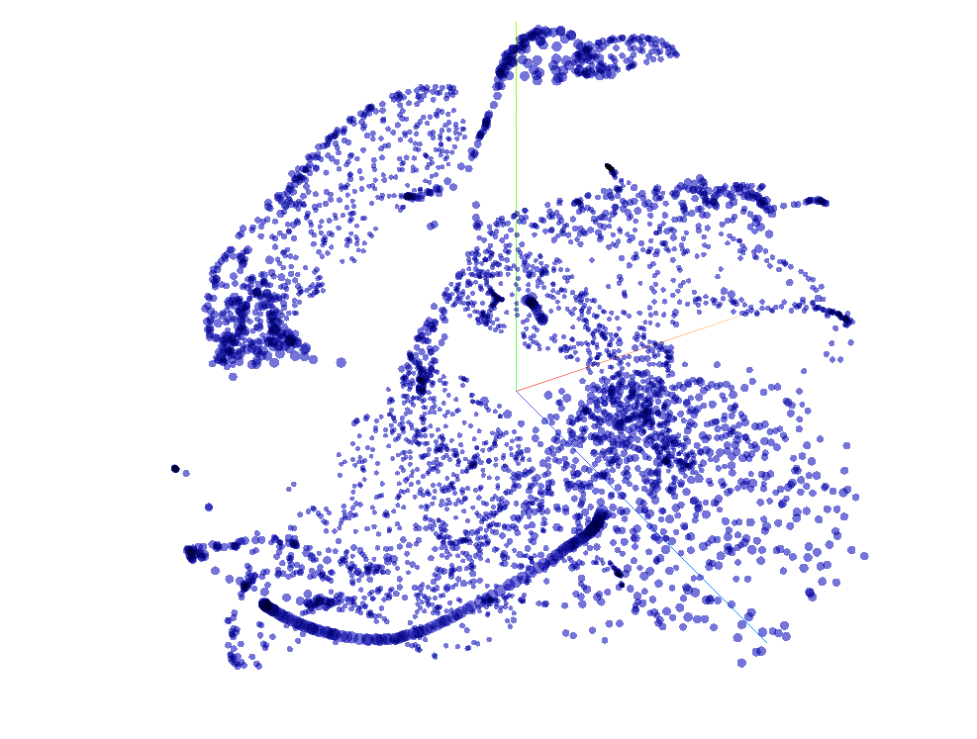
Embedding Space: Linear vs Non-Linear Projection
Based on Model v6.2.391
PCA
T-SNE

Slide 63
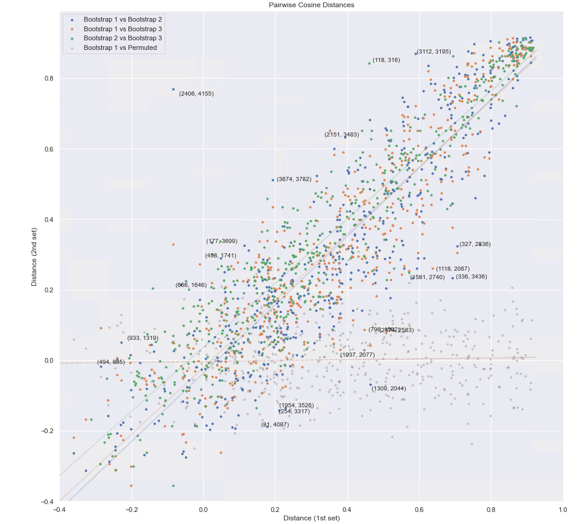
Robustness of the Embedding Space I
Based on Model v6.2.391
To evaluate robustness:
Pre-trained 3 models (same configuration) on different data sets (i.e. divided all data into three random chunks)
Randomly selected 10 000 pairs of concepts and calculated cosine distance between them (for each of the model i.e., each pair has three distances calculated
Plotted distances for each pair.
In the perfect scenario points would lie on a straight line. In the worst case, the points would be scattered randomly.
Gray points show the distribution for permuted dataset (i.e., the case without any consistency)
Distances for trained models seem to form a line, i.e. consistent

Slide 64
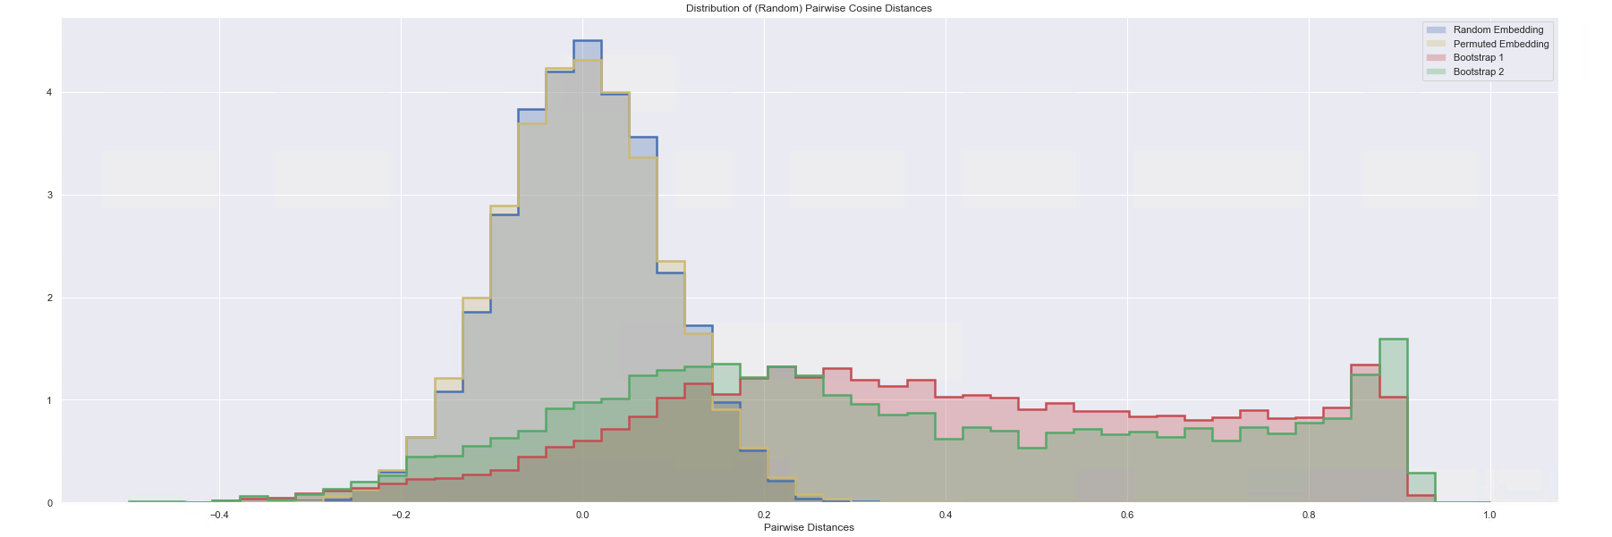
Robustness of the Embedding Space II
Based on Model v6.2.391
Distribution of pairwise cosine distances:
The distribution of distances for the trained models seem to differ from the random and permuted set of distances
Hence, the embedding space has its own structure that can be replicated

Slide 65
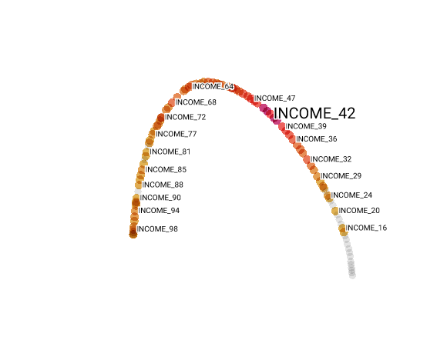
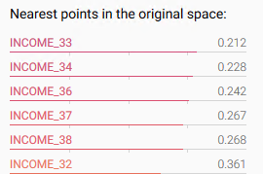
Concept Space: Income
Based on Model v6.2.391
In concept-space (non-linear 2D projection):
Income is arranged sequentially
Concept for INCOME49 is closer to INCOME50 and INCOME48
Closest concepts to INCOME35 (cosine distance)

Slide 66
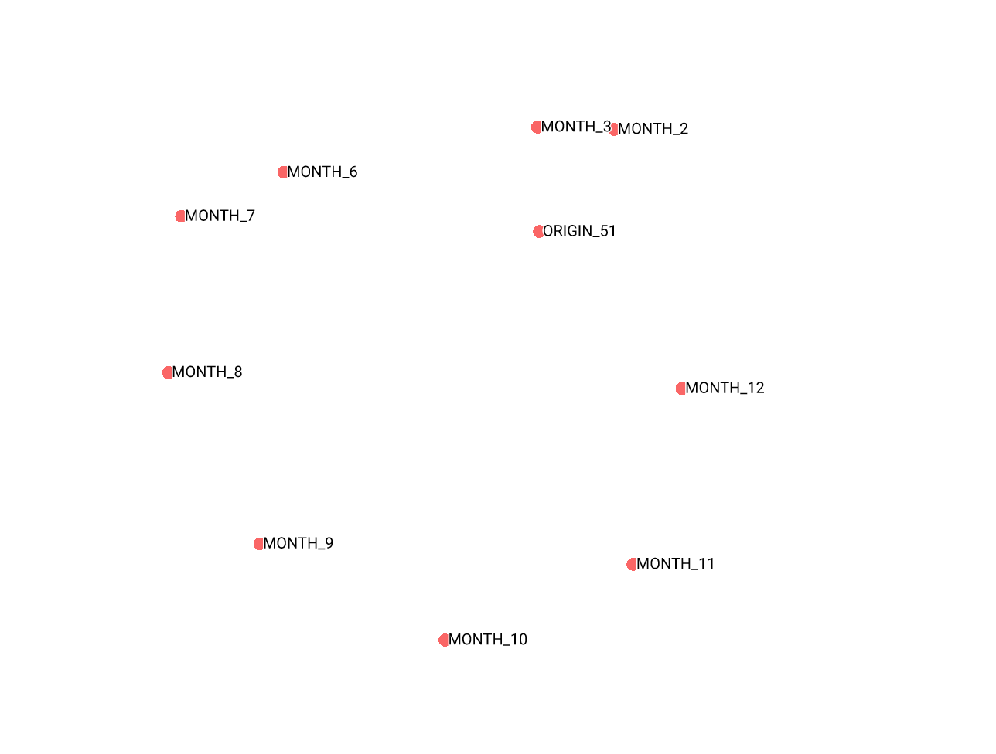
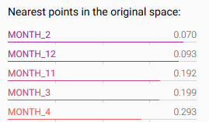
Concept Space: Months
Based on Model v6.2.391
In concept-space (non-linear 2D projection):
MONTHS are also arranged sequentially
Concept for JANUARY is close to DECEMBER and FEBRUARY
Same goes for YEARS
Closest concepts to JANUARY (cosine distance)

Slide 67
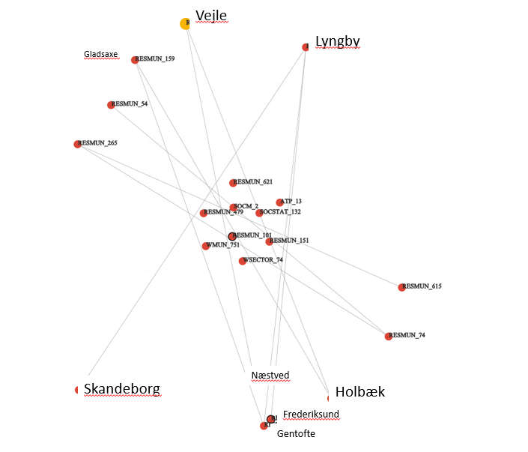
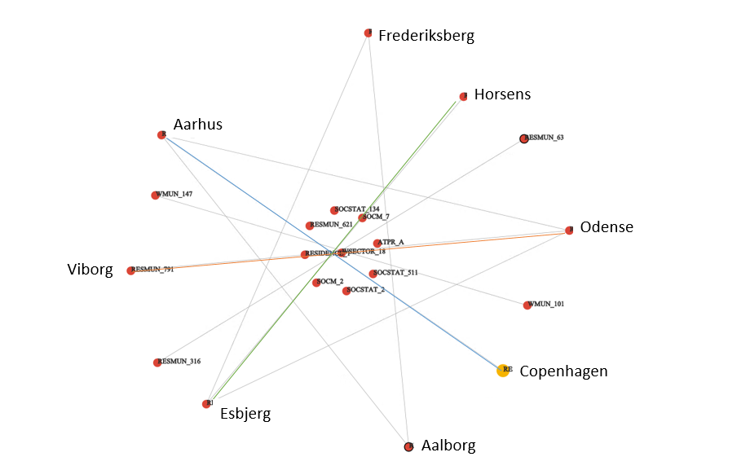
Concept Space: Municipalities
Based on Model v6.2.391
The distances between the Municipality concept
Top 20 closest concepts to Copenhagen. Edge exists if cosine distance is larger than 0.6, lengths of the edges do not have any meaning. We can see that Copenhagen is closer to other large communes in Denmark
Top 20 closest concepts to Vejle. Edge exists if cosine distance is larger than 0.6, lengths of the edges do not have any meaning. We can see that Vejle is closer to other small communes in Denmark

Slide 68
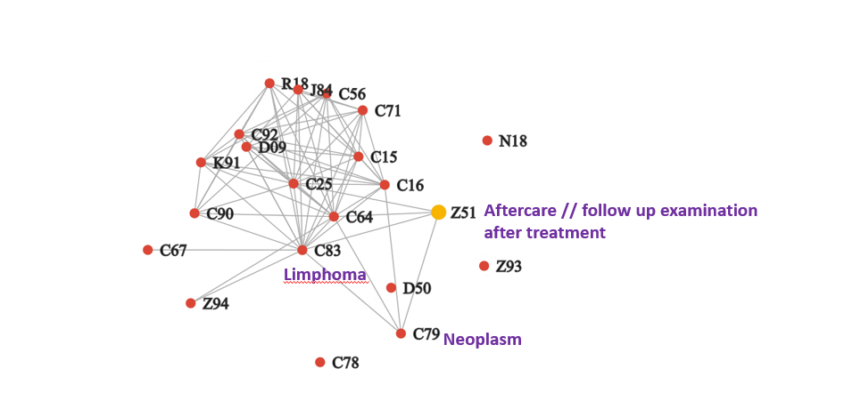
Embeddings of Diagnoses I
Based on Model v6.2.391
Top 20 closest concepts to Z51 (Aftercare in ICD10 system)
The term for the aftercare is connected to Neoplasms (C-class in ICD10)
Here the lengths of the edges specifies the closeness of concepts
The positions of points do not represent the distances

Slide 69
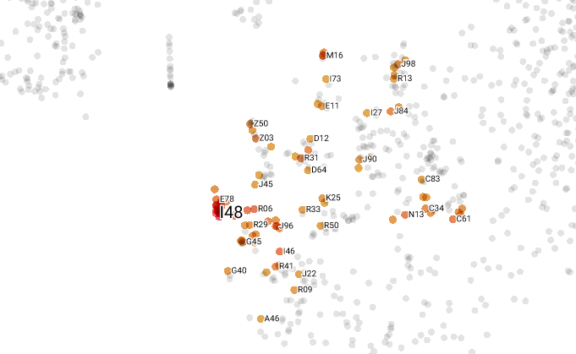
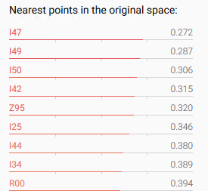
Embeddings of Diagnoses II
Based on Model v6.2.391
We pick a concept I48 (Atrial fibrillation and flutte)
On the right, we can see closest concepts to I48:
I50 (Heart Failure)
I49 (Other cardiac arrhythmias)
I47 (Paroxysmal tachycardia)
Z95 (Presence of cardiac and vascular implants and grafts)
The concept of I48 is also close to:
Management of the main activity within pedagogical work with and care for children (POSITION: 134100)
Embossing of coins (INDUSTRY: 3212)

Slide 70
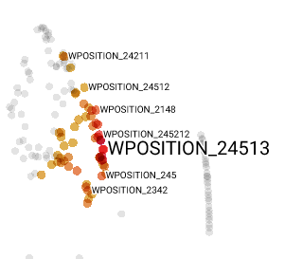
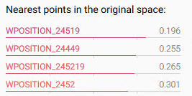
Embeddings of Positions
Based on Model v6.2.391
Closest concepts to 24513 (General journalistic work):
Work within economics and social sciences
Journalism and arts
Linguistics

Slide 71
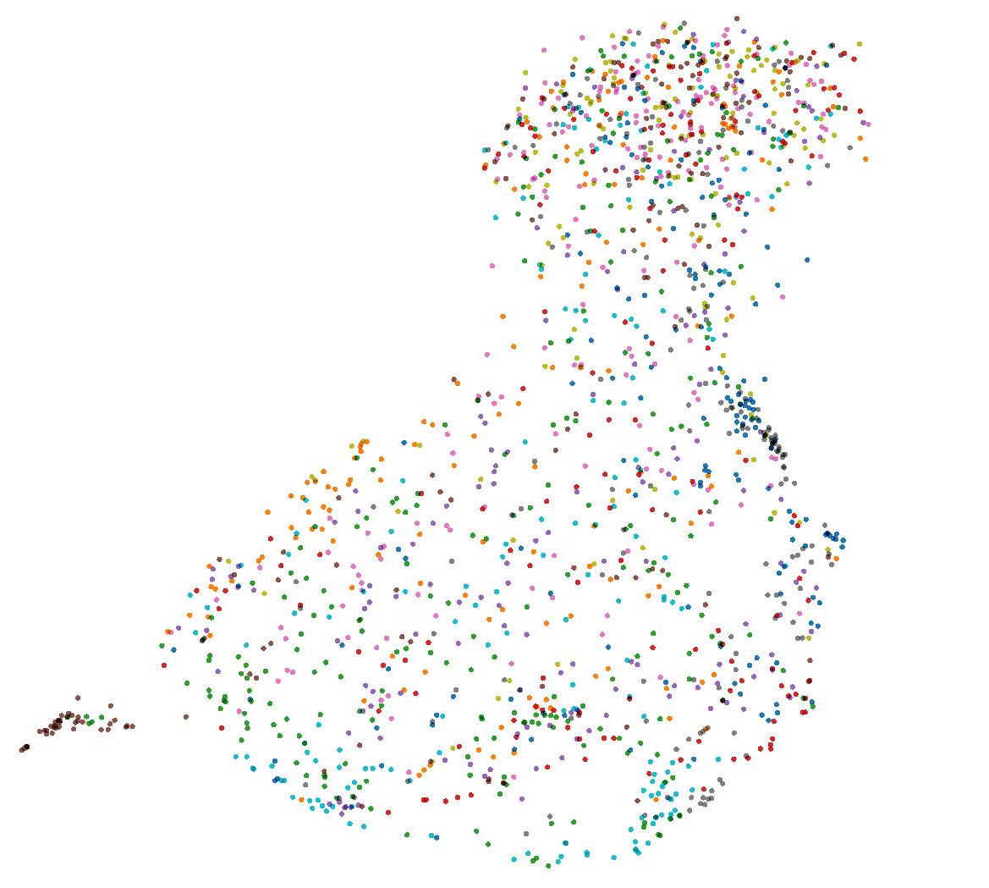
Health Embeddings (Isolated)
Based on Model v6.2.391

Slide 72
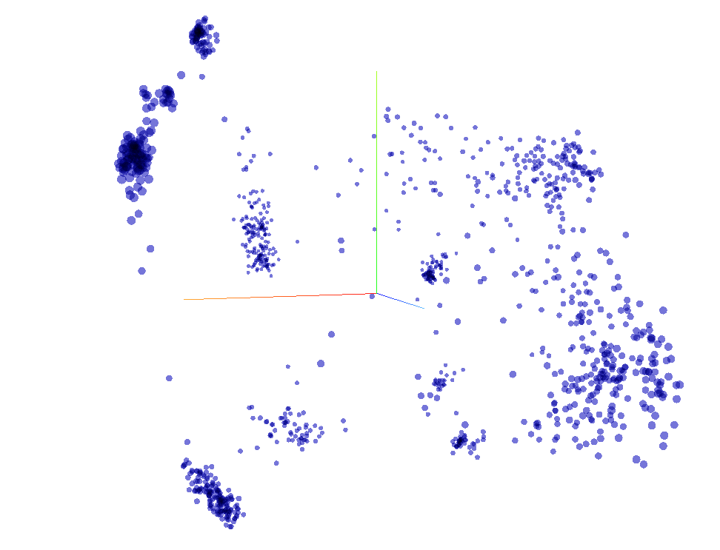
Representation of people
Based on Model v3.02
Each point corresponds to a person (i.e. person’s sequence)
We can see clusters:
For now, they are most probably meaningless
Since (here) we did not assign any task to CLS token.

Slide 73
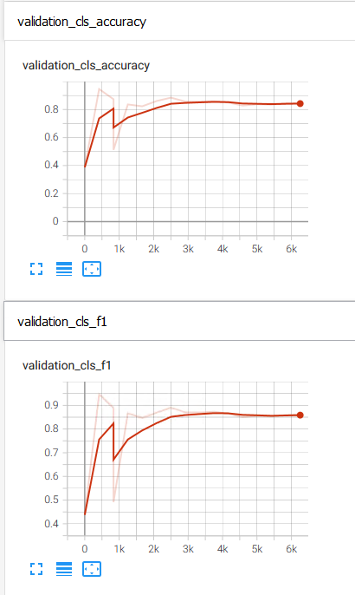
Experiment I: End-of-Sequence (EOS) Predictions
Finetuning on death End-of-Sequence task (on [CLS] token):
Is the provided sequence is going to end in a death?
Excluded missing people and emigrants
When assessing performance - accounted for imbalance
Weighted F1-Score
Weighted F1-Score
Training Steps
Training Steps
F1-score = 2 TP/(2 TP + FP + FN) = (2 * Pr * Rec) / (Pr + Rec)

Slide 74



End-of-Sequence Predictions: PR-Curve
Positive Class: Sequence ends with the death
False +
True +
False -
Comparison to Mortality Tables:
Prediction based on statistics from the previous year
Considers only age and sex
Overlapped PR-Curves (loosely)
Baseline
Precision
Recall
Precision
Our model
Random classifier would look like that
Precision
Recall
* both are evaluated on validation set
Recall
Image Source

Slide 75

EOS Predictions: Where does the model look?
When making a prediction:
CLS Token is here (we make a prediction based on it)
Bright lines are [SEP] tokens, i.e. model does not change
attends to the beginning of a sequence
Background information is here
Notice the darker shades
… as well as, to the end of a sequence
Last records

Slide 76
EOS Predictions: Step Further
Checking whether we're doing better than insurance companies
Preliminary existential crisis over free will
Ethical concerns
Add Explainability component (i.e. what it takes into account):
Gradient-based Saliency
Probing the Neuron Activation
Ablation Studies:
Does it look at the beckground, or it just attends to the first tokens in the sequence

Slide 77


Gradient Based Saliency as Explainability Tool
Performer-type self-attention does not allow to look at the attention scores (or at least, it is quite complicated)
But we can look at the derivatives of inputs in respect to predictions!
Example: Saliency identifies important words – comparable to human performance
Atanasova, P., Simonsen, J.G., Lioma, C. and Augenstein, I., 2020. A diagnostic study of explainability techniques for text classification. arXiv preprint arXiv:2009.13295.
Alammar, J. (n.d.). The Illustrated Transformer. [online] Interfaces for Explaining Transformer Language Models. Available at: https://jalammar.github.io/illustrated-transformer/.

Slide 78

Neuron Activations as Explainability Tool

Slide 79


Life Trajectories: Visualization
Based on sentence similarity:
Jaccard distance
(Top) change in relation to the first 5 events (in the sequence)
(Bottom) skip for now

Slide 80


Life Trajectories: Visualization
A timeline is folded into itself in such a way that similar time points end up being close to each other
Bach, B., Shi, C., Heulot, N., Madhyastha, T., Grabowski, T. and Dragicevic, P., 2015. Time curves: Folding time to visualize patterns of temporal evolution in data. IEEE transactions on visualization and computer graphics, 22(1), pp.559-568.

Slide 81
Work in Progress
Assign task for a CLS token on pre-training:
Can CLS token extract information such as diagnoses, municipalities etc.
Finetuning:
Unemployment task
Disease prediction

Slide 82
Ethical Considerations
Part 4

Slide 83

Ethical Concerns
State authorizing research on behalf of citizens
Could be reproduced by the less-ethical states and/or industry
Unlike ethical hackers, we cannot produce a fix for vulnerabilities
We do not know how it would extrapolate to the unseen data
Image source

Slide 84
Possible Directions
Stuff from Street-level Bureaucrats paper ??

Slide 85
Thank you for attention

